Slide 1

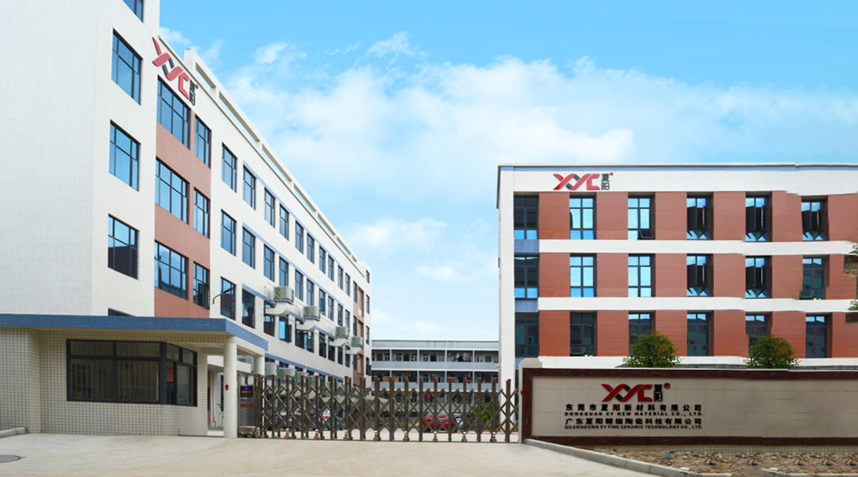
Striving for Excellence,Independent Innovation, Customer Achievement, Harmonious Win-Win
About XYC
Dongguan XY New Material Co., Ltd.
www.xycmat.com

Slide 2
Contents
1
3
Application area
Company Introduction
2
Material Introduction
4
Business Scope

Slide 3



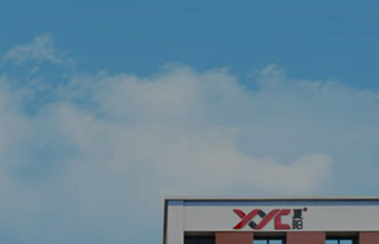
Enterprise Culture
Mission
Build an innovative and combat-effective team, strive to become a world-renowned brand in advanced ceramics, and drive humanity’s development over the next century with the power of atoms.
Corporate Vision
Dedicate to becoming a renowned global brand in advanced ceramics.
Corporate Spirit
Strive for perfection, pursue progress, pioneer innovation, and keep transcending
Team Work
Respect, Passion,
Positivity, Unity

Slide 4
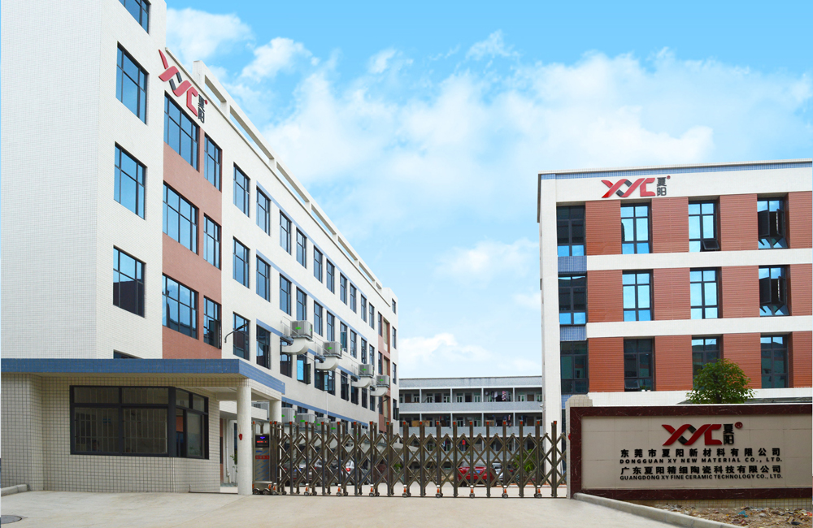
Company Profile
XYC is a R & D and manufacturer specializing in advanced ceramic materials and precision components. It is also a solution provider with over 20 years of experience in the application of a full range of superhard materials. Our products are widely used in many high - end fields, such as laser semiconductors, food and medical, new energy vehicles, petrochemicals, national defense and military industry, and aerospace.
Since its establishment in 2001, XY has accumulated rich experience in the precision processing of advanced ceramic materials and cemented carbide (also known as tungsten carbide in some cases). Since 2012, it has become one of the few companies in China with a complete industrial chain covering powder molding, sintering, precision manufacturing, and application solutions. It is also one of the few material manufacturers in China engaged in the systematic and comprehensive development of zirconia, alumina, silicon nitride, silicon carbide, zirconium magnesium oxide, aluminum nitride, and tungsten carbide.
4
20+
years
1000+
28500
㎡
30+
300+
Production bases
Industry experience
R & D Personnel
Employees
Served Customers
Production workshop

Slide 5


Development Milestones
Cooperate with Tsinghua University to become a graduate internship base for Tsinghua University
2017.03
To become a globally leading comprehensive advanced ceramics enterprise.
Established a ceramic sintering production line and laboratory
2016.12
Awarded as a Chinese high-tech enterprise
2018.04
2016.08
The silicon nitride material trial succeeded and entered production
Successfully tested and developed Zirconia and Alumina products
New factory area put into use
2018.11
2014.12
Technical Support from Shanghai Institute of Ceramics, Chinese Academy of Sciences
2025.07
The silicon carbide material trial succeeded and entered production.
The 4th Production Base - Huizhou XY Production Base Established
XY Precision was established
2014.08
2020.05
2004
2024.10
2011.11
The 3rd Production Base - Anhui XY Production Base Established
Establish cooperation with RSH Germany
2011.10
2022.09
2023.02
German office established
Cooperated with BYD, DJI, and Huawei. Established industry - university - research bases with Tsinghua University and Changsha University of Science and Technology, implementing project - based initiatives.
A provincial - level ceramic lab was inaugurated.
2023.01
Received Guangdong's "Specialized & Sophisticated" honor
Corporate Vision
A World - Renowned Brand in Global Advanced Ceramics

Slide 6
Organizational Structure
Board of Directors
Board of Supervisors
Chairman of the Board
Strategic Decision - Making Committee
General Manager
General Manager's Office (GMO)
R & D and Technology Center
Supply Chain Center
Production Operations Center
Marketing
Center
Human Resources Center
Finance and Risk Control Center
Digital Information Center
R & D Dept.
Procurement Dept.
Engineering Dept.
Marketing Planning Dept.
Human Resources Dept.
Finance Dept.
Digitalization Dept.
Technology Development Dept.
Quality Control Dept.
PMC Dept.
Overseas Dept.
Administrative Dept.
Financing Dept.
Information Dept.
Lab.
Production Base
Domestic Sales Dept.
Risk Control Dept.
Customer Service Dept.

Slide 7
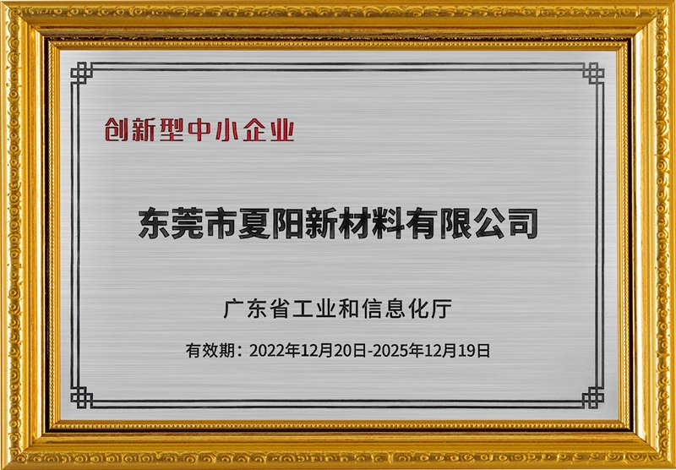
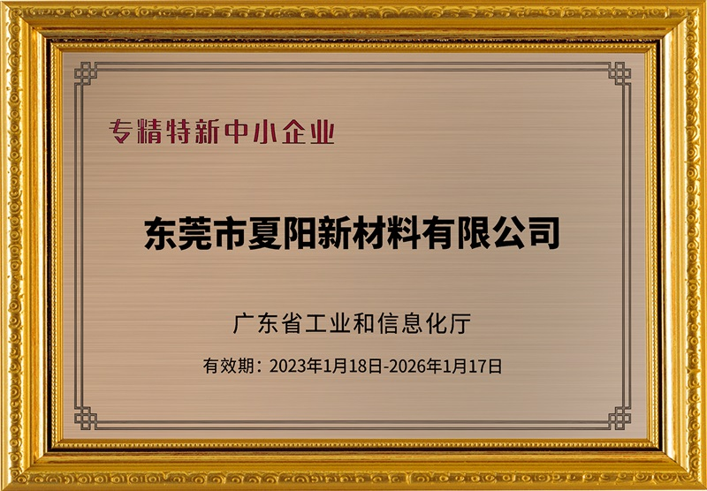
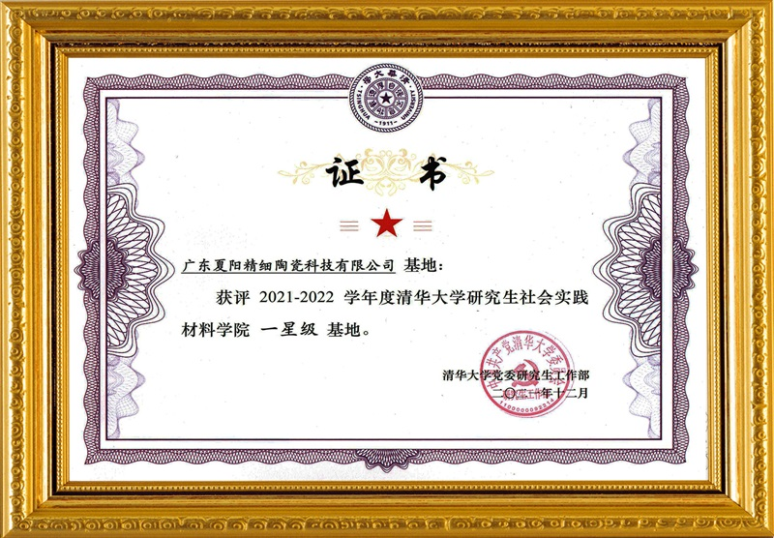
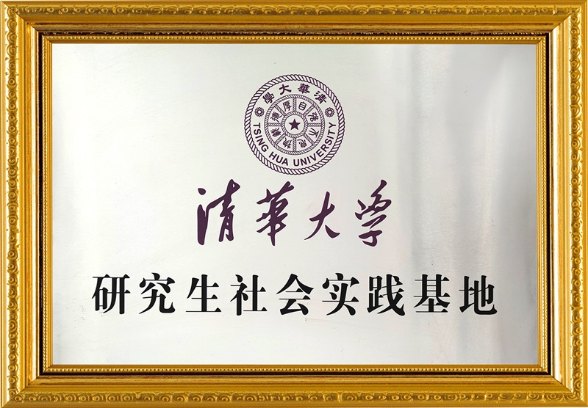
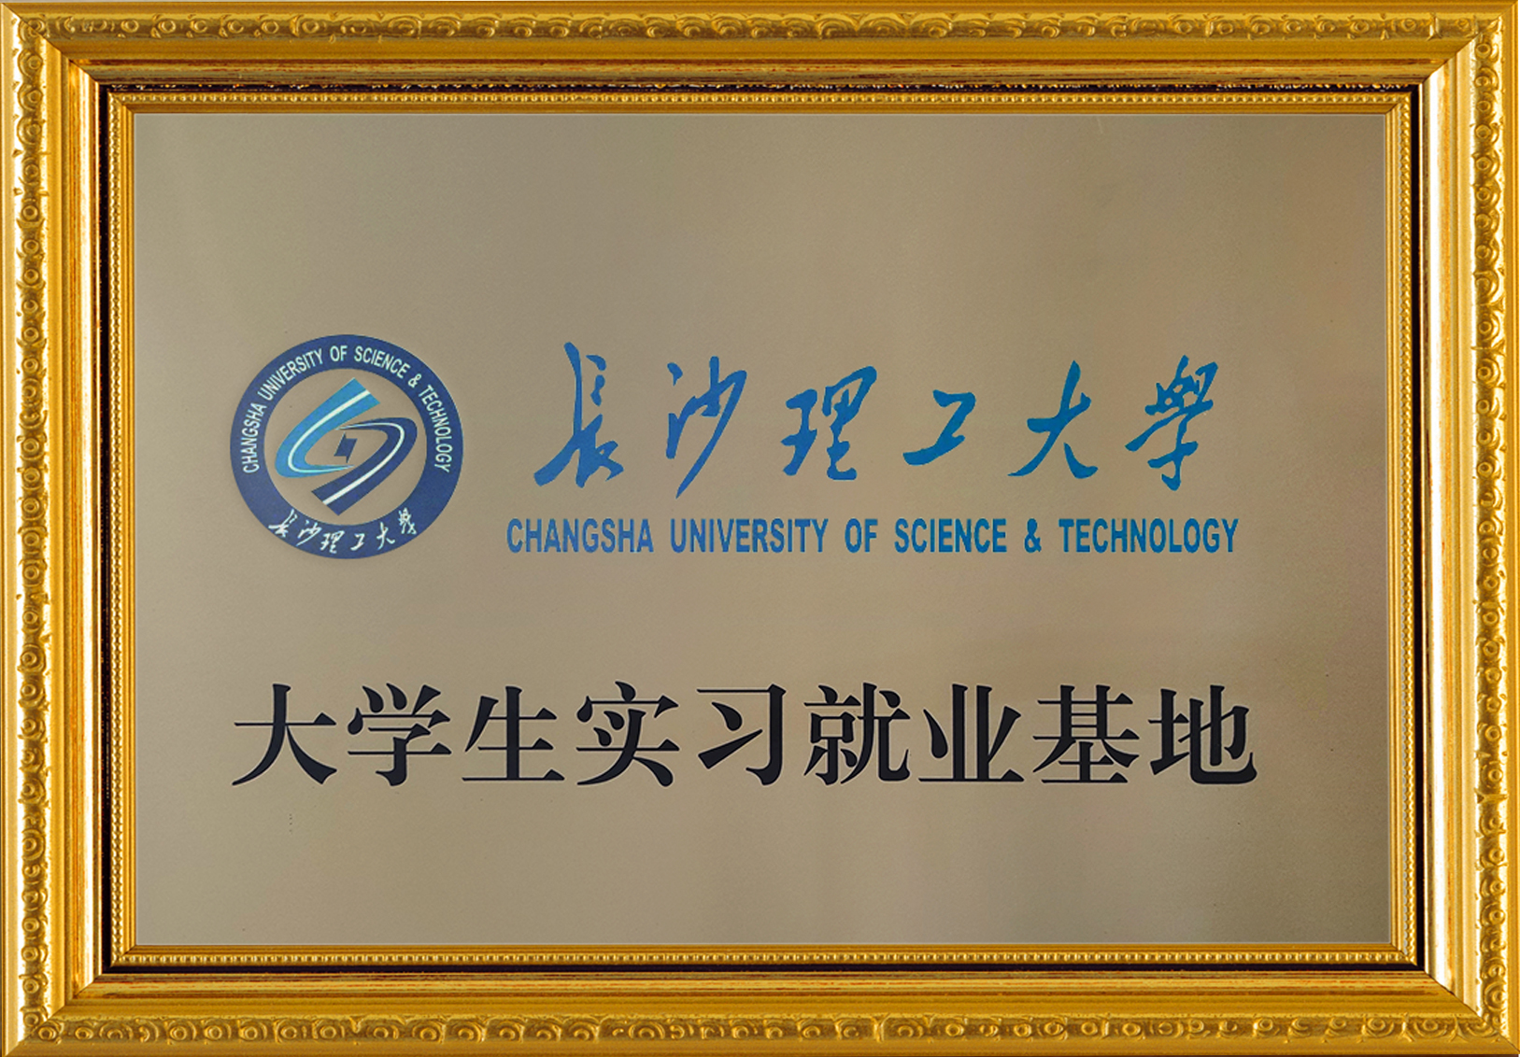
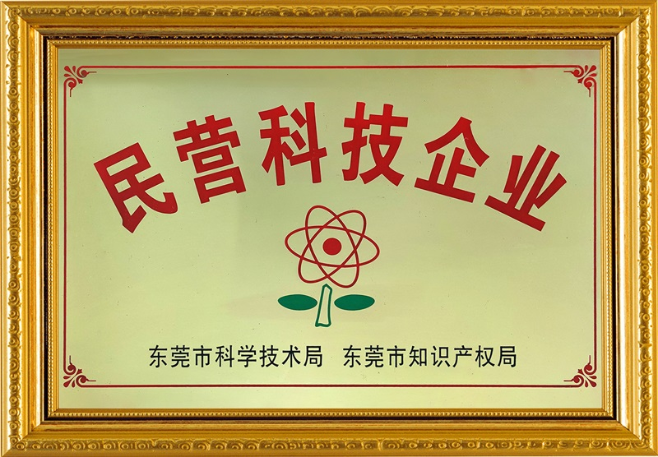
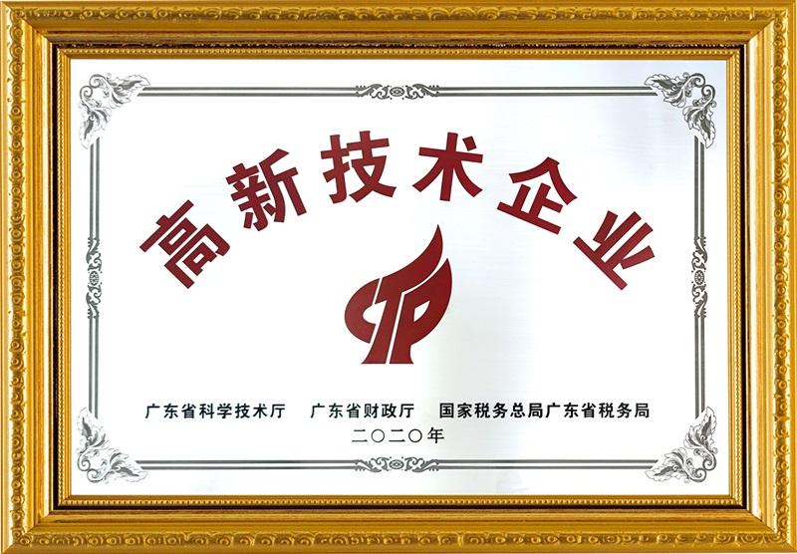
Company Honors
Innovative small and medium-sized enterprises
Specialized in special new small and medium-sized enterprises
School of Graduate Materials, Tsinghua University
one - star base
Tsinghua University graduate Social Practice base
Guangdong technical school internship and employment base
Private science and technology enterprise
High-tech Enterprise

Slide 8

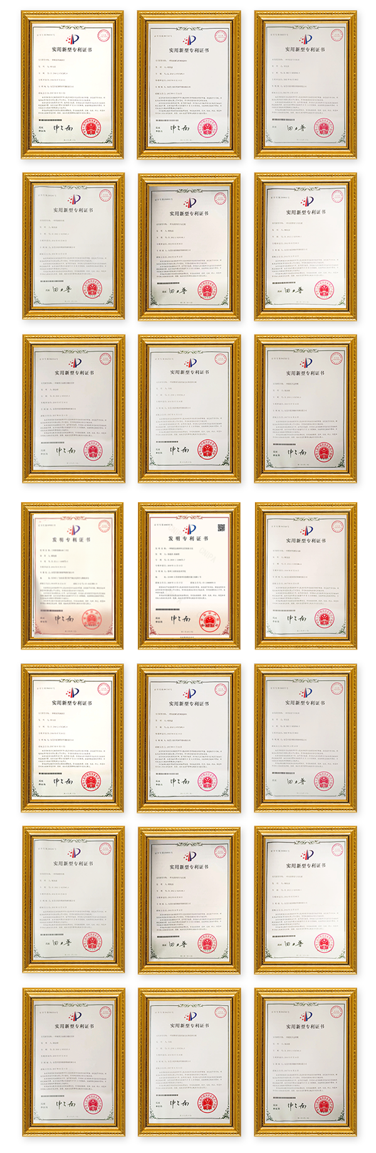
Company patents
Strong technical strength
Obtained many patents
XYC has a number of technical and research and development personnel, at the same time with the major research institutes, well-known schools and enterprises cooperation, through their own continuous research and development, obtained a large number of technical patents.

Slide 9
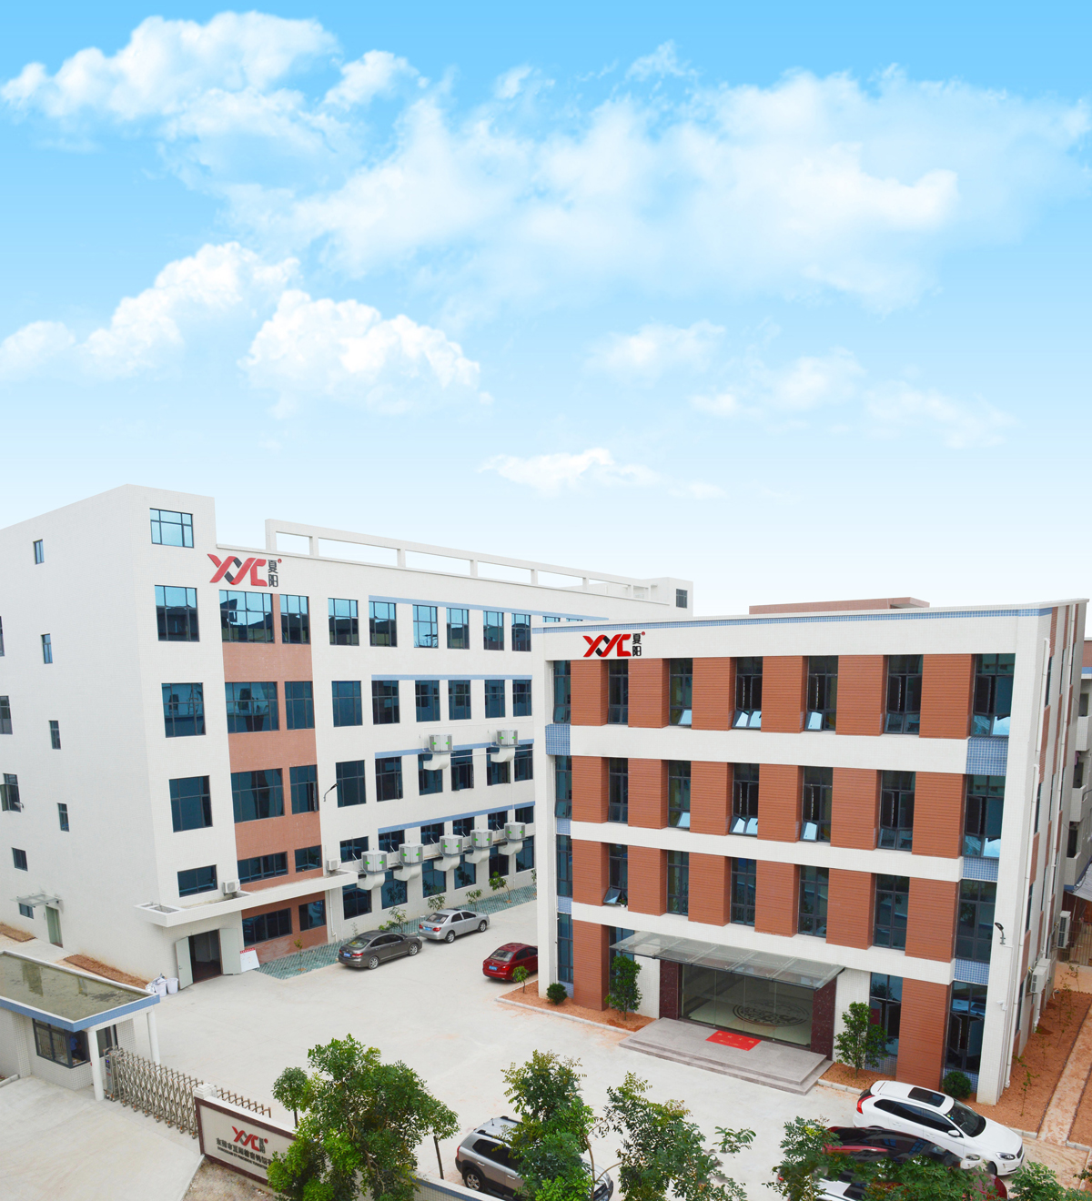
Company Advantages
With more than 20 years of experience in ultra precision manufacturing
Industry-leading R&D team
XYC has renowned professors and PhDs in the ceramic materials industry, over thirty professionals, and strong research and development capabilities supported by research institutes and universities.
Since its establishment, XYC has specialized in precision machining. With 20 years of ultra - precision manufacturing experience, it can achieve sub - nanometer form tolerances in some cases.
Complete processing and testing equipment
Advanced Ceramic Full Industry Chain Company
Sintering equipments: Pressure sintering furnace, Vacuum sintering furnace,Tunnel kiln, etc
Processing equipments: CNC five-axis precision engraving machine, Pptical curve grinding machine, Mirror spark machine, Achishimir slow wire walking machine,Segment difference machine, etc
Detection equipments: Electron microscope scanner, Zeiss three-dimensional, Cylindricity meter, Profile meter, etc
Formula → Forming → Sintering → Precision Manufacturing → High Clean Surface Treatment → Scheme Testing are all completed by our company.
Strict quality control measures
XYC has established IQC, IPQC, OQC departments, and has a number of high-precision testing equipment, strict quality control and provide suitable application solutions.
It has provided solutions to more than 2000 customers worldwide
Domestic 4 hours, the world within 24 hours to provide you with materials, application solutions.

Slide 10
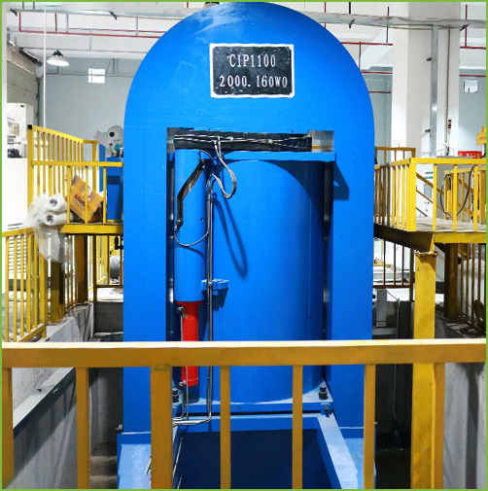
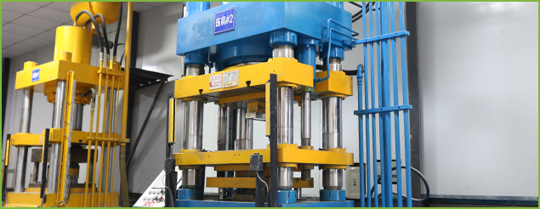
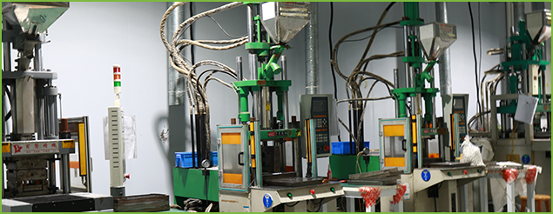
Company Equipments
Molding equipment: Injection molding machines, Dry presses, Cold isostatic presses, etc.

Slide 11
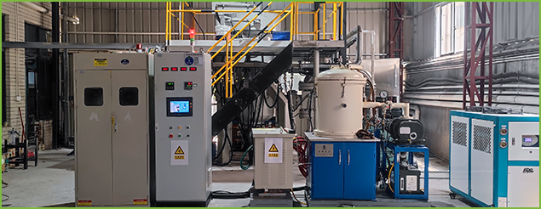
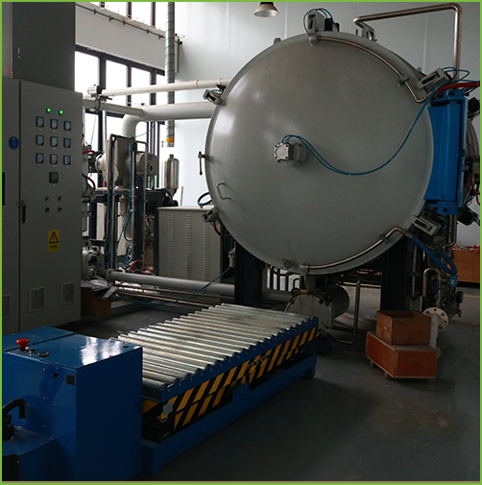
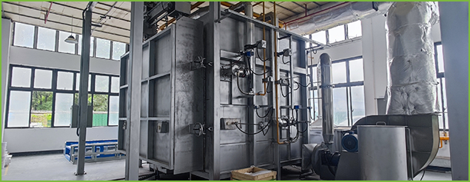
Company Equipments
Sintering equipment: Vacuum carbon tube furnaces, Gas pressure furnaces, High - temperature furnaces, Medium - temperature furnaces, Degumming furnaces, etc.

Slide 12
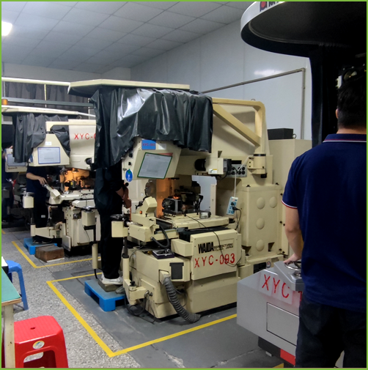
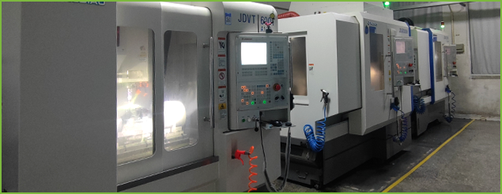
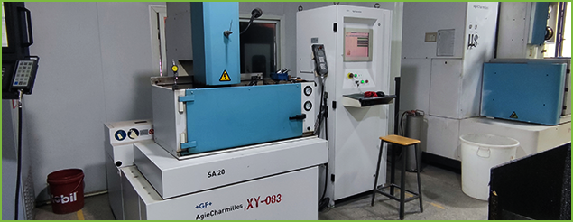
Company Equipments
Processing equipment: AgieCharmilles E.D.M low-speed wire-cutting machine, Five-axis CNC engraving machine, Optical profile grinder, Cylindrical grinder, Surface grinder, etc.

Slide 13
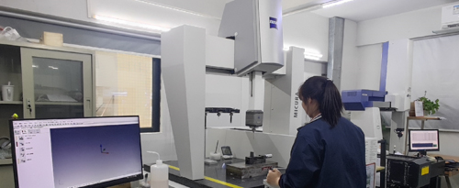
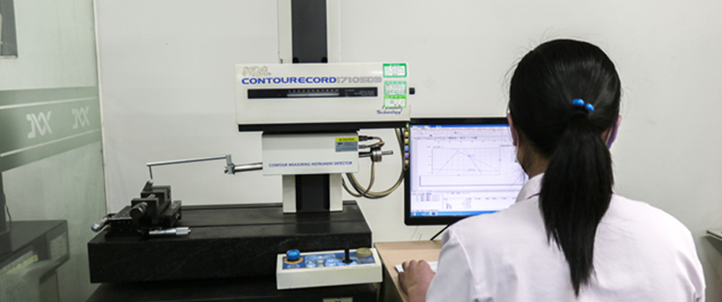
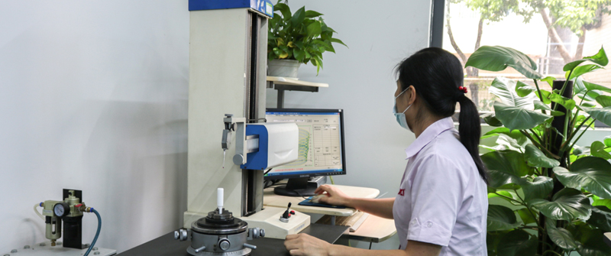
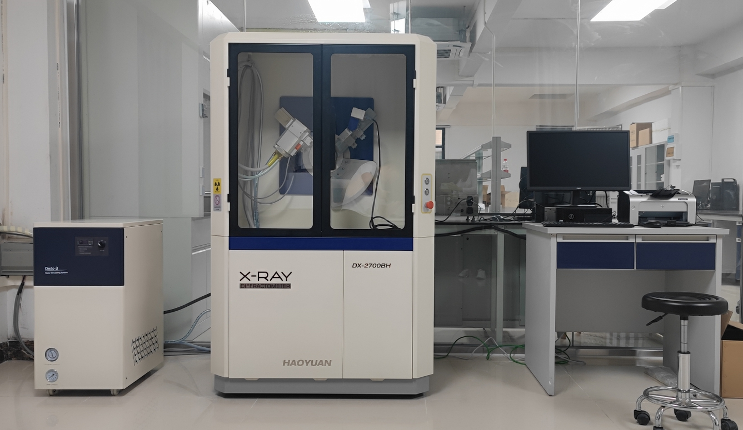
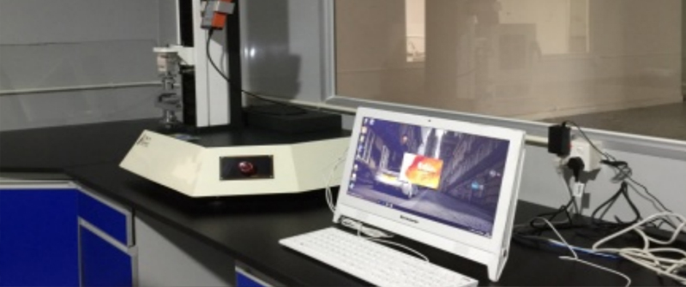
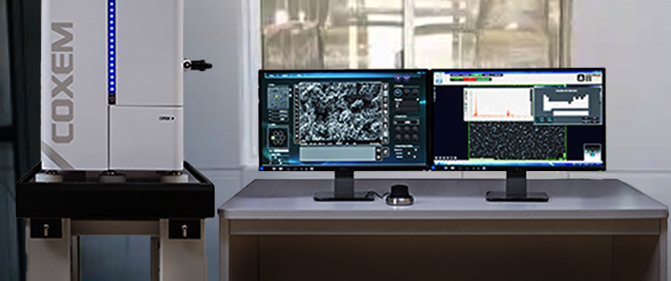
Company Equipments
Testing Equipments
Zeiss three-coordinate
Measure Machine
Profile Projector
Roundness Measuring Instrument
XRD (X-ray Diffractometer)
Flexural Strength Tester
Materials Scanning Electron Microscope

Slide 14

XYC Materials
Advanced Ceramics
Tungsten Carbide
XY fine advanced ceramics have ultra-high temperature resistance, high hardness, acid and alkali corrosion resistance, no magnetic conductivity, no electricity, special light color effect, products are widely used in aerospace, communications, military, automotive, chemical, medical, electronics, photovoltaic new energy, luxury, smart wear, precision machinery and other industries.
XY fine ceramic manufacturing production:Zirconia, Zirconia magnesium oxide, Toughened zirconia, Alumina, Silicon nitride, Silicon carbide and color ceramics!
Tungsten Carbide has high hardness, wear resistance, strength and toughness, good heat resistance, corrosion resistance and a series of excellent properties, especially its high hardness and wear resistance, even at 500℃ temperature is basically unchanged, at 800℃ still has a high hardness.
Material research and development
Complete processing equipments
Application solution offering
XY has a self-built material research and development room, and has reached a material research and testing cooperation with the School of Materials, Tsinghua University, and has self-research ability in the field of material research and development.
XYC has a number of precision processing equipments, from material forming, sintering to precision processing, XYC has a whole process of each process of processing equipment.
XYC customers at home and abroad, service customers up to 2000+, accumulated a wealth of application cases, can provide customers with all kinds of solutions.

Slide 15
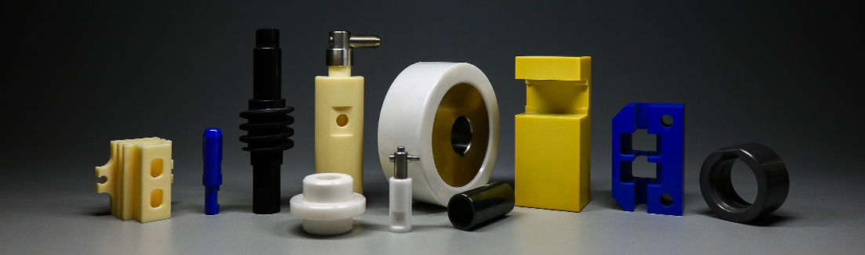
Complete series of Ceramics
Advanced ceramics
The Commonality
of Advanced Ceramics
With excellent toughness, hardness, electrical insulation, good heat resistance, good wear resistance, good oxidation resistance and other characteristics, with the progress of industry, more and more industries began to use advanced ceramics instead of traditional materials.
Zirconia
Ceramics
Alumina
Ceramics
Silicon Nitride
Ceramics
Silicon Carbide
Ceramics
Aluminum nitride
ceramics
ALN
ZrO2
Al2O3
Si3N4
SiC

Slide 16

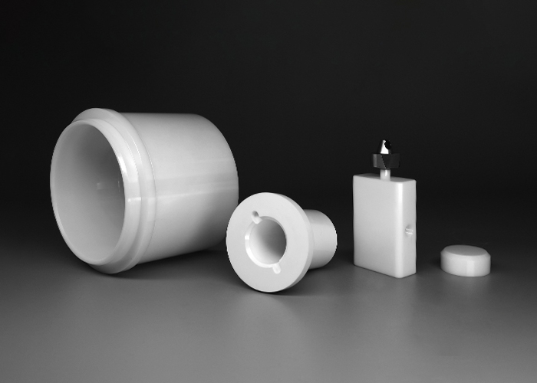
Zirconia Ceramics
Material properties
Zirconia (ZrO2)
Ceramics with the Best Toughness
Extremely high toughness 6-10 MPam1/2
Excellent heat insulation/low thermal conductivity (3W/MK)
Maximum operating temperature 1000℃
Excellent chemical stability
High thermal expansion performance (A=10X10-6/K, close to steel)
Application Characteristics
Zirconia not only has high hardness, high wear resistance, but also fine ceramics toughness is very good material, so it is often used in structural parts, wear parts. It also has a thermal expansion coefficient close to steel, so it is often used to connect ceramics and steel material, zirconia in addition to commonly used in the field of industrial structural parts, because of its jade like texture, in life ceramics also has a wide range of applications.
Application Areas
Welding industry: welding heat insulation sheet
Lithium pool new energy source: diaphragm cutter
Medical instrument: plunger quantitative pump, chemical experiment bowl, medical mold
Automobile industry: automobile exhaust zirconia sensor
Detector: plug gauge, standard gauge, detection needle
Mechanical engineering: guide column guide sleeve, sealing ring, sealing sleeve, photovoltaic roll, valve core valve sleeve, bearing, grinding machine accessories
3C electronics: watch circle and mirror, back plate/fingerprint piece/center frame of mobile phone, knife, bracelet, pendant, headset, smart speaker

Slide 17

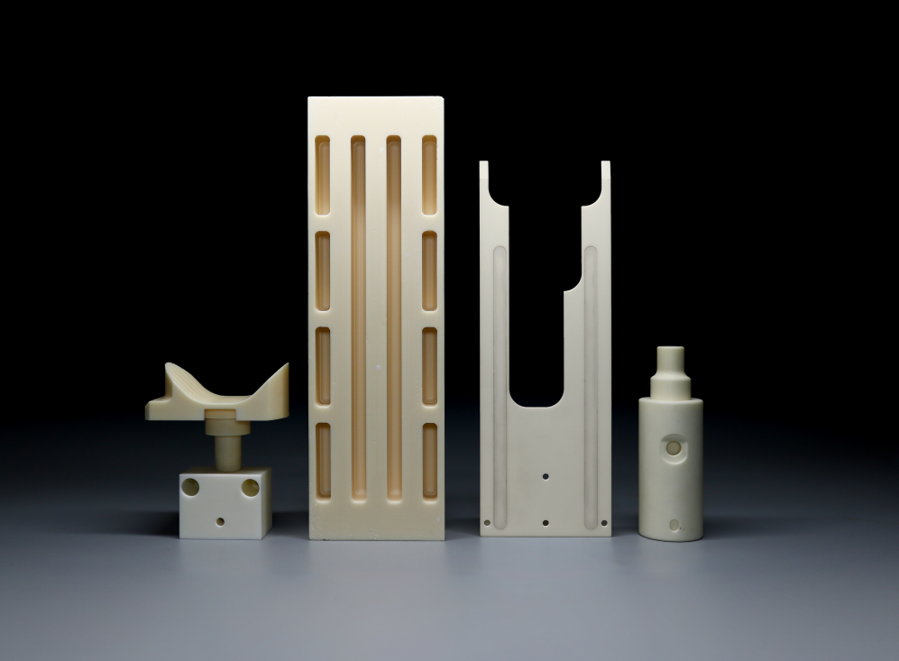
Alumina Ceramics
Material Properties
Alumina (AL2O3)
Materials with the Best Price and Value
High hardness HRA90 ~ 93
Excellent resistivity (1X10)
Medium to super high mechanical strength (360-600 MPa）
Extremely high compressive strength (2250-2700 N/mm²）
Low thermal conductivity (25-32W/MK)
The maximum operating temperature is 1200° C.
Application Characteristics
Alumina has high hardness, high melting point, corrosion resistance, high resistivity, low cost, moderate surface activity, good adhesion, shock resistance and shielding effect. Thicker ones are used in abrasive or polishing industries. Flake alumina is used in ceramic reinforcement materials, cosmetics, advanced coatings and other fields.
Application Areas
Smelting: Crucible, chemical apparatus dish
Machinery industry: grinder grinding disc, turbine and casting wheel
Electrical line: electrical circuit base plate, tube seat, outer shell
Automobile industry: automobile tail gas catalyst carrier
New energy industry: powder delivery equipment for large mold
Industry wear resistance: hydraulic pressure valve sleeve

Slide 18

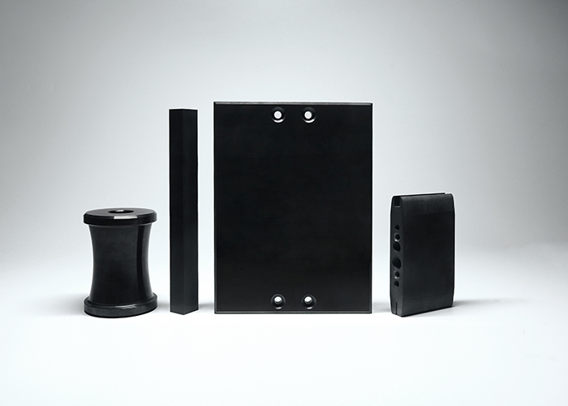
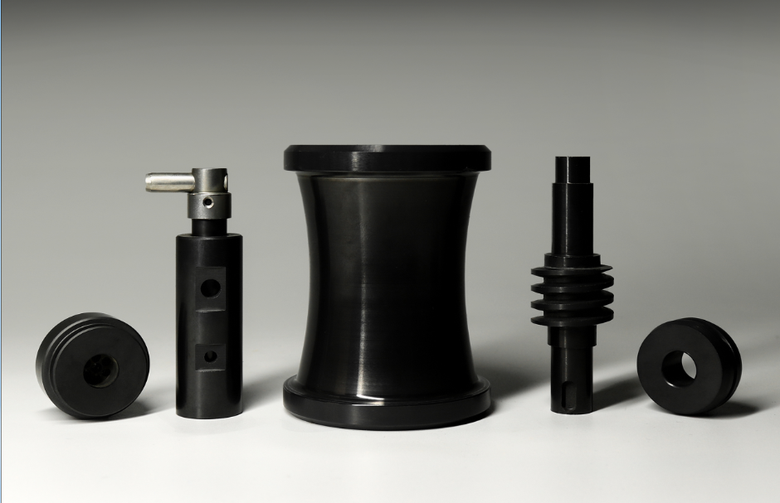
Silicon Carbide Ceramics
Material Properties
Silicon Carbide (SiC )
Superhard Ceramic Material
Very low density (3.20g/cm³)
Extremely high hardness: (94 HRA)
High heat conductivity (8 0W/ MK)
Low expansion coefficient (4.5 ×10-6 / K,400℃)
Maximum operating temperature: 1600℃
Good corrosion and wear resistance at high temperature
Application Characteristics
Silicon carbide is almost like diamonds. It is not only the lightest, but also the hardest ceramic material, with excellent thermal conductivity, low thermal expansion, very resistant to acid and alkali, and does not crack easily in hot and cold environments.
So silicon carbide is excellent kiln materials, furnace materials, high temperature damage resistance parts. The excellent resistance of SIC to corrosion, wear and erosion is as good as its ability to withstand friction and wear.
Application Areas
● Stone oil (valve, nozzle)
● Chemical processing (sealing parts)
● Machinery industry (bearing, ball)
● Aerospace (gas turbine blade, turbocharger rotor)

Slide 19

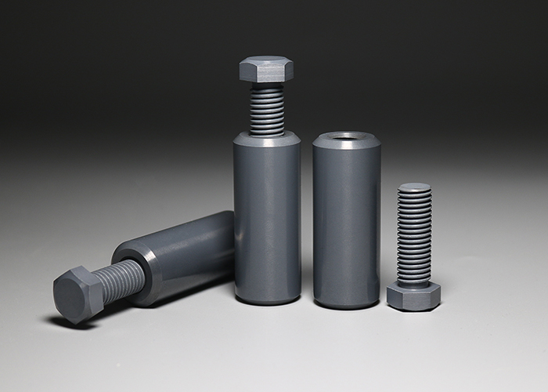
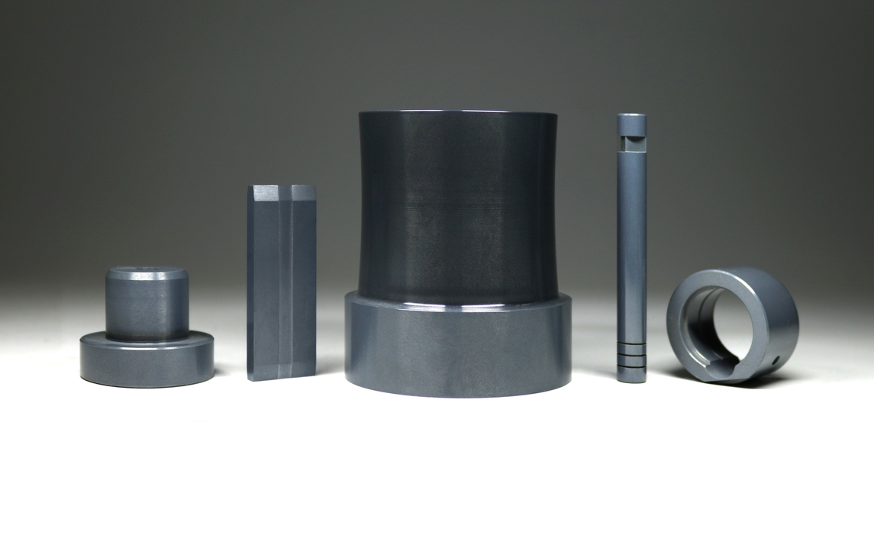
Silicon Nitride Ceramics
Material Properties
Silicon Nitride (Si3N4)
Materials with Excellent
Comprehensive Properties
Extremely high hardness (92.5HRA)
Good bending strength (850 MPa)
Very low density (3.20g/cm³)
Excellent fracture toughness (6 ~ 7.0 MPam 1/2)
Very low coefficient of thermal expansion(3.2X10-6/K)
Maximum operating temperature :1400℃
Application Characteristics
Silicon nitride has an excellent combination of material properties. Low density, but extremely hard, and because of the special crystal structure gives excellent thermal stability, and high fracture toughness. It is a better choice for use in extreme conditions. Therefore, silicon nitride ceramics is the best choice for high-speed high precision bearings, but also high temperature molding, high-speed tools, high temperature wear-resistant parts of the important material!
Application Areas
Machinery industry: smelting iron and steel loading solution tools, plunger high pressure pump, automotive drawing mold
New energy industry: powder treatment pump, valve
Petrochemical: sealing ring, sealing pump, sealing valve
Metal forming: spring (non-stick material)
Welding industry: welding roll forming roll (high temperature, non-conductive)
Automotive industry: automotive internal combustion engine heat resistant parts
National defense: aircraft turbine engines, ceramic blades, turbine outer rings and air bearings
Can be used as heating body, for electric water heater, air conditioning heater, thermostat, steam generator, etc

Slide 20

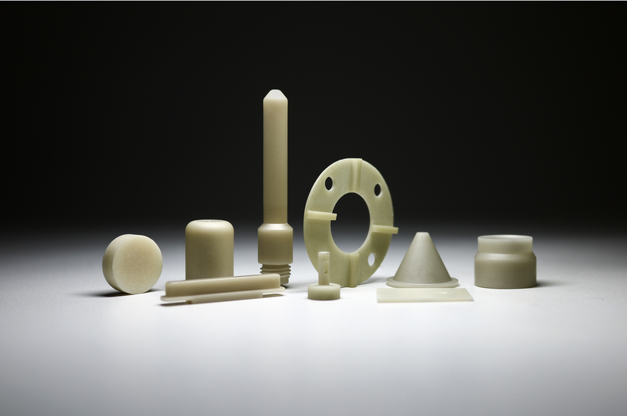
Aluminum Nitride ceramics
Material Properties
Excellent thermal conductivity (170W/m · K)
Low coefficient of expansion (4.5/10 K )
Dielectric constant (14kv/mm)
Elastic modulus (220Gpa)
Bending strength (320Mpa)
Maximum operating temperature: 2200 ℃
Aluminum nitride (ALN)
The best thermal conductivity ceramic
-6
-1
Application Characteristics
In advanced ceramics, aluminum nitride (AIN) is renowned for its high thermal conductivity, excellent electrical insulation, low dielectric constant and loss, as well as outstanding resistance to plasma erosion and non toxicity.
Especially at high temperatures, it also has excellent bending resistance. In addition, aluminum nitride ceramics also have the characteristic of not being corroded by molten aluminum, other molten metals, and gallium arsenide, especially with excellent corrosion resistance to molten aluminum.
Application Areas
● Semiconductor industry: heat dissipation substrates or heat sinks
● Medical devices: suitable for manufacturing medical devices such as artificial joints and dental restorations
● ‌Automotive industry: cooling modules and motor components
● ‌Aerospace: Gas turbine components such as turbine blades and combustion chambers
● Microwave communication: substrate and packaging of microwave circuits
● ‌Metal smelting: High temperature reaction vessels and furnace linings

Slide 21
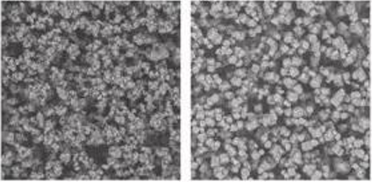
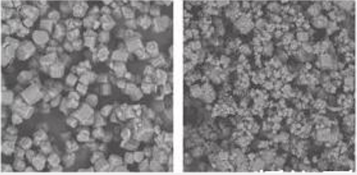
Silicon Nitride Powder
Silicon Nitride(Si3N4) powder
— Materials with excellent comprehensive properties
Benchmarking enterprises
Germany AlzChem
Application Areas
● High Thermal Conductivity Silicon Nitride Ceramic Substrate Powder
● High-Performance Silicon Nitride Ceramic Bearing Ball Powder
● Silicon Nitride Structural Ceramic Powder

Slide 22
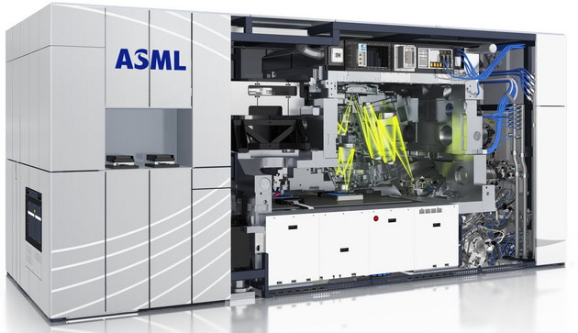
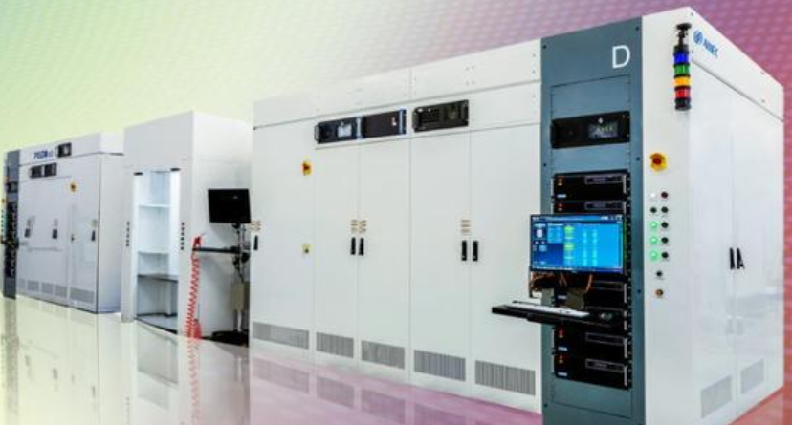


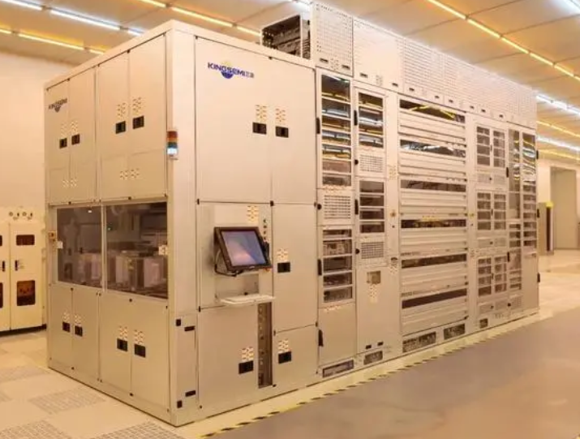

Application industry: Pan-semiconductor industry
Technological process | Photolithography | Etching | Thin film deposition | Ion implantation | Coating and Developing | Oxidation, Diffusion, Annealing, Alloying, etc.
Application of ceramic product equipment | Photolithography machines | Etching machine | PVD、CVD and ALD equipment | Ion implantation equipment | Photolithography Machine、Coating and Developing Equipment | Oxidation and Diffusion Equipment
Equipment diagram
Advanced ceramic material component products | Workpiece stage Guide rail Mirror Vacuum Chuck Robotic arm Water-cooled plate | Ring and Cylinder Category Airflow Guidance Category Load-Bearing and Fixing Category Gripper Spacer Category Guide Rail Module | Ring and Cylinder Category, Airflow Guidance Category, Load-Bearing and Fixing Category, Gripper Spacer Category, Module | Circular cylinder type Load bearing fixed type Claw pad type | Load bearing fixed type Claw pad type | Load bearing fixed type Claw pad type Module
Main material types of the product | Al2O3 ,Si3N4, SiC | ZrO2,Al2O3,SiC | ZrO2,Al2O3,SiC | ZrO2,Al2O3,SiC | Al2O3,SiC | Al2O3

Slide 23
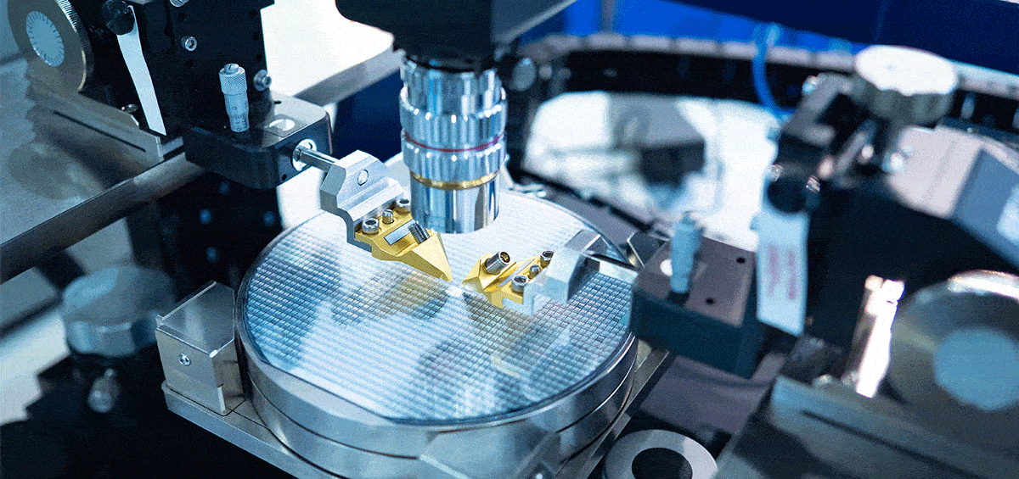
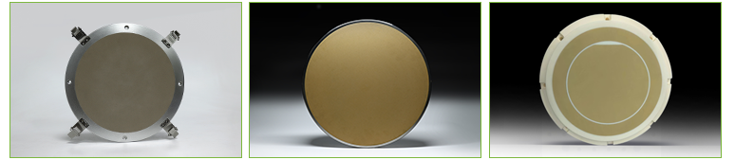
Application industries:Pan-semiconductor industry
Ceramic
Vacuum Chuck
Purpose:
The ceramic vacuum chuck is a special kind of vacuum chuck, made of porous ceramic material. It features high porosity, high strength, high flatness and other characteristics, and is widely applied in the processes such as cutting, grinding and testing of semiconductor wafers.
Material | Pore Size (μm) | Porosity | Pressure Difference (bar) | Resistivity | Color
Aluminum Oxide | 5 - 50 | 15 - 45% | 35 | 1×10¹¹ | Dark gray, Earth yellow
Silicon Carbide | 10 - 50 | 15 - 45% | 30 | 1×10⁸ | Black
The flatness can reach 0.002mm,
and the parallelism can reach 0.003mm.
High precision
Excellent airtightness
Uniform adsorption force
Wear-resistant and corrosion-resistant

Slide 24
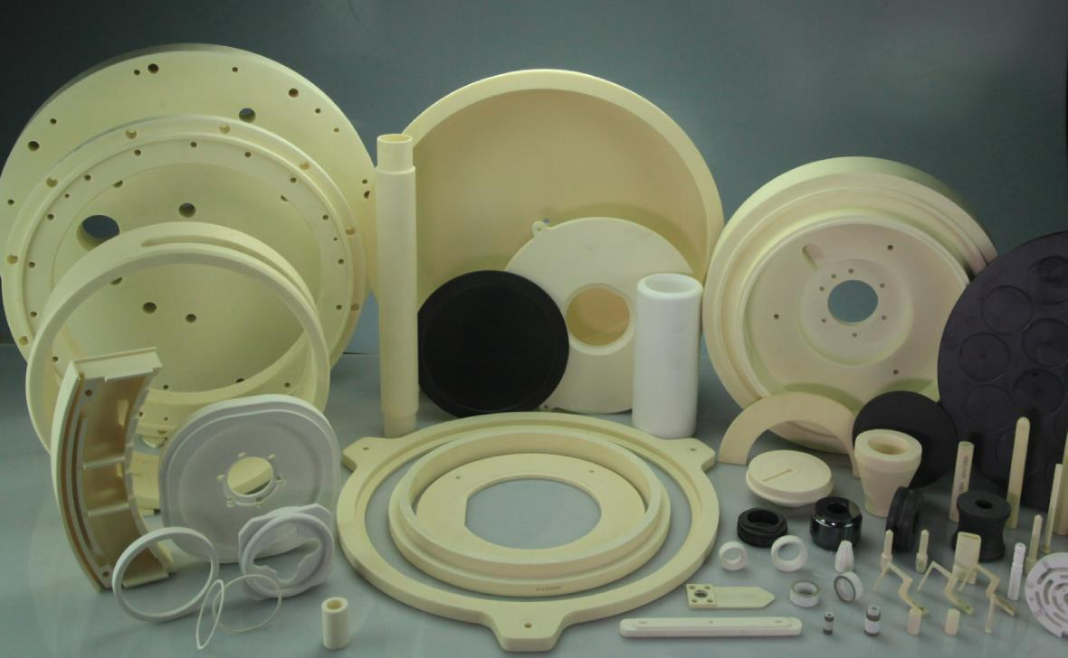
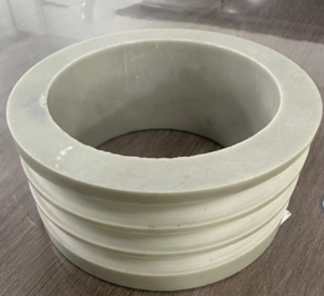
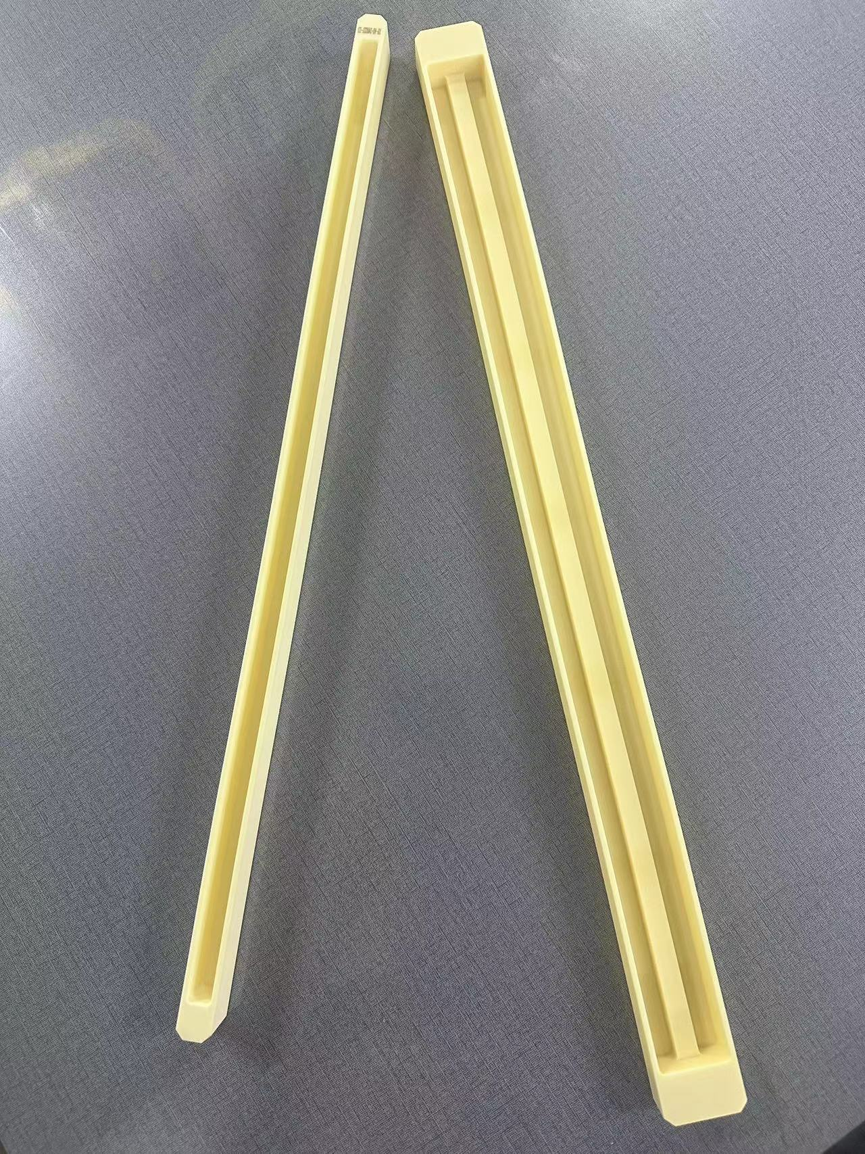
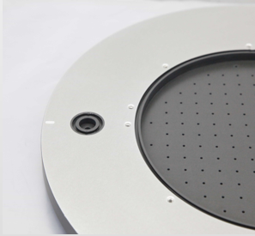

Application industries:Pan-semiconductor industry
Ceramic Components
Purpose:
The advanced ceramic material components of the semiconductor equipment manufactured by XY are mainly applied inside the chamber. Some of these components directly come into contact with the semiconductor wafers, and they are key precision components in the manufacturing of integrated circuits

Slide 25
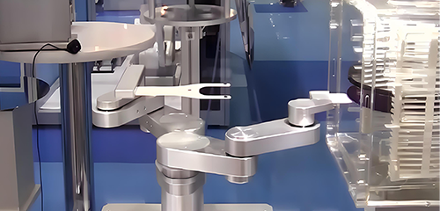
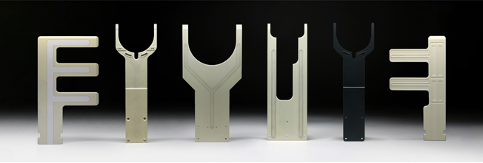
Application industries:Pan-semiconductor industry
Ceramic
Robotic Arm
Purpose:
It is used for wafer and LED production transfer, effectively preventing wafer scratches and surface contamination.
High precision
Excellent airtightness
High-temperature resistance
Controllable surface resistivity
Self-sealing test: Close the vacuum source, negative pressure from -85Kpa to -80Kpa, lasting more than 60 seconds.
Wafer adsorption test: Close the vacuum source, negative pressure from -80Kpa to -25Kpa, lasting more than 35 seconds.
Product Performance | Unit | Type | Parameter
Resistivity | Ω | Silicon Carbide | 1×10⁵
 |  | Alumina Oxide | 1×10¹⁴
Maximum Service Temperature | °C | Split - type Arm | 350
 |  | Integrated Arm | 800
Adsorption Surface Finish | Ra | 0.01
Adsorption Surface Flatness | mm | Within 0.01

Slide 26
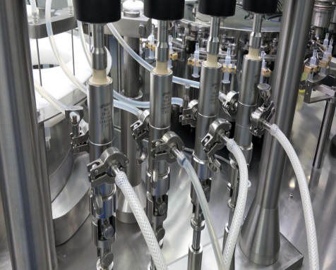
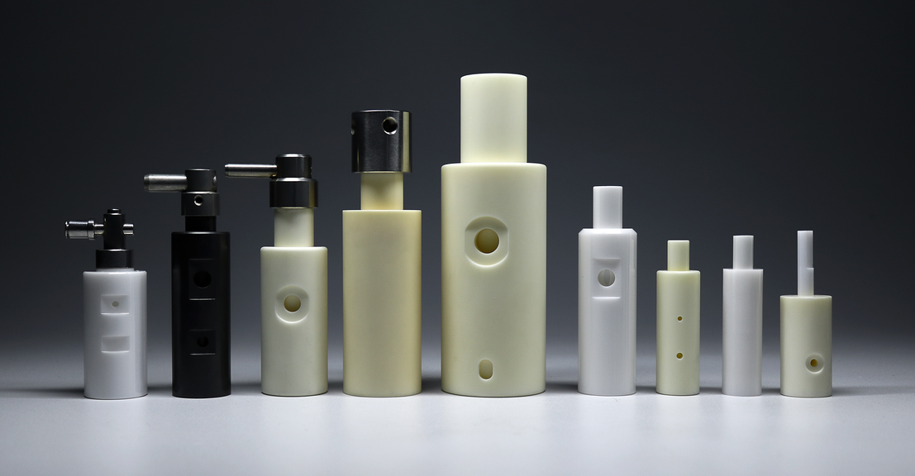
Application industries: Healthcare, Fluid-related
Valve Core
and Valve Sleeve
Usage
The valve core sleeve is an important device in the filling (liquid) system. It realizes the suction and discharge of liquid by relying on the reciprocating movement of the plunger in the cylinder. It uses the precise fit of the ceramic plunger and the plunger sleeve. It is a plunger-type precision metering pump used for metering transportation or quantitative filling.
Application requirements
Advantages of ceramic materials
The ceramic material has inherent advantages. It has lower thermal conductivity than metals and is a good insulator. Its expansion coefficient is also lower. It is not prone to oxidation and resists acids, alkalis, and salts well. (It is acid and alkali resistant, high temperature resistant, and suitable for harsh liquid environments.)
Good sealing performance
The characteristics of ceramic materials, such as high tensile strength, not easy to deform, high temperature resistance, low temperature resistance, wear resistance and non-corrosion, determine the excellent sealing performance of ceramic materials.
Long service life
Ceramic materials have good physical properties, high hardness, high wear resistance and long service life.
High precision
Product has high precision with a roundness of 0.001mm. It is green, environmentally friendly and pollution-free.

Slide 27





Application industries:New energy
Calendering wheel
Subdivided industries: New energy,Solar photovoltaic,Enamelled wire,FFC,wire and cable
Usage
The calendering wheel is used for calendering precision flat copper wires, copper foil wires, flat copper wires for photovoltaic welding tapes, and bare copper wires for FFC conductors. It is assembled on the special calendering bracket of the calendering machine. The surface of the calendering wheel is in contact with the wire surface. By adjusting the calendering gap and
applying a certain pressure, the wire is calendered at a certain calendering speed to meet the
product requirements .
of a certain width and thickness.
Application requirements
Strict appearance requirements:
Customers have extremely strict requirements for product appearance. There must be no scratches or black spots visible to the naked eye. (The product is installed in the equipment and displayed on the outside).
Long service life:
The single service life of the roll surface varies from 3 months to 3 years. The requirements of customers for materials and processing precision determine the service life of the product.
High inspection standards:
Customer inspection methods: inspection of key dimensions, installation and commissioning on the machine. Whether the width and thickness dimensions of the wire meet the standard, whether the surface finish is qualified. Whether the wear resistance of the roller meets the life requirements.

Slide 28


Application industries:New energy
Classification Wheel
— Specifically designed for the separation
of particle sizes in powders.
Usage
Under the powerful centrifugal force generated by the high-speed rotating classification turbine, coarse and fine materials moving with the upward airflow are separated in the classification zone. Fine particles that meet the size requirements pass through the classification wheel and are collected in the next component, while coarse particles descend to the crushing zone for further grinding. Widely used in equipment such as jet mills and mechanical mills.
Application requirements
High wear resistance and hardness
The high-speed rotating spiral crushing classification wheel is resistant to wear during prolonged use, extending its service life.
No metal contamination
Due to the parabolic shape and high surface roughness, it does not produce metal rust, thus avoiding metal contamination. This is particularly important for processes sensitive to metal contamination, such as the processing of nickel, chromium, and cobalt ore materials.

Slide 29





Application industries:New energy
Dispensing equipment parts
Usage
Dispensing machine, also known as glue coating machine, glue dripping machine, glue dispensing machine, glue filling machine, etc., is an automated equipment specially used for controlling fluids and dripping and coating fluids on the surface or inside products. In order to improve work efficiency and increase service life, more and more key parts and components are
beginning to be replaced by advanced ceramics.
Application requirements
Strict appearance requirements:
Customers have extremely strict requirements for product appearance. There must be no scratches or black spots visible to the naked eye. (The product is installed in the equipment and displayed on the outside).
Short supply cycle:
The equipment cycle is short, about 7 days. The products we mainly supply are ceramic parts, and delivery is required in about 20 to 30 days.
High inspection standards:
The customer's inspection method is 100% full inspection.

Slide 30

Tungsten Carbide
Tungsten Carbide
XY has more than 20 years of experience in the field of tungsten carbide materials, and has accumulated a wealth of cases. XYC will give very suitable material selection suggestions according to the customer's product use environment and use purpose.
Wear-resistant series
Wear and impact resistant series
High temperature resistant series
Non-magnetic series
Ultrafine particle series

Slide 31


Global Market Distribution
1
China
2
Europe
2
6
3
North America
1
3
4
South America
5
5
Africa
4
7
6
Russia
7
Australia
35％ Overseas 65％ Domestic

Slide 32


Quality Control
QE
Quality Control
IQC
IPQC
OQC
50%
25%
20%
5%
Raw Material
Process flow
Production process
Other

Slide 33

A
COMPANY LOGO
公司标志位置
THANK YOU
Dongguan XY New Material Co., Ltd.
Address: No.28, Xiangkou Road, Huangnitang Industrial Park,
Changping Town, Dongguan City, Guangdong, China
Tel: +86-0769-83939973 +86-0769-81892162
Website: www.xycmat.com
www.xycera.com
www.xycmat.com

